Slide 1
Welcome to you all.

Slide 2
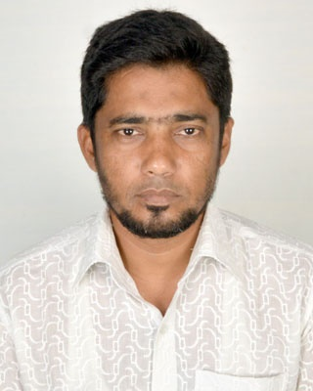
introducing
Md. Nur Kutubul Alam .M.A;B.ed
ICT Teacher
Shaplakali Adarsha Secondary School
Jibannagar , Chuadanga
Cell phone-01913207130
Email-arenacomputer1@gmail.com
Sub :- English 2nd paper
Class :- Nine
Theme:- Grammar
Time :- 50 minutes

Slide 3
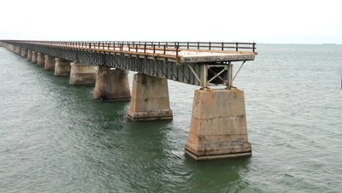
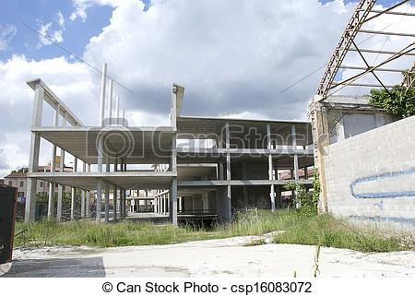
What can you see in the pictures?
Though the contractor got enough time,
in time for want of money.
he couldn’t complete the bridge
If you want live in the house,
You have
to complete it.

Slide 4
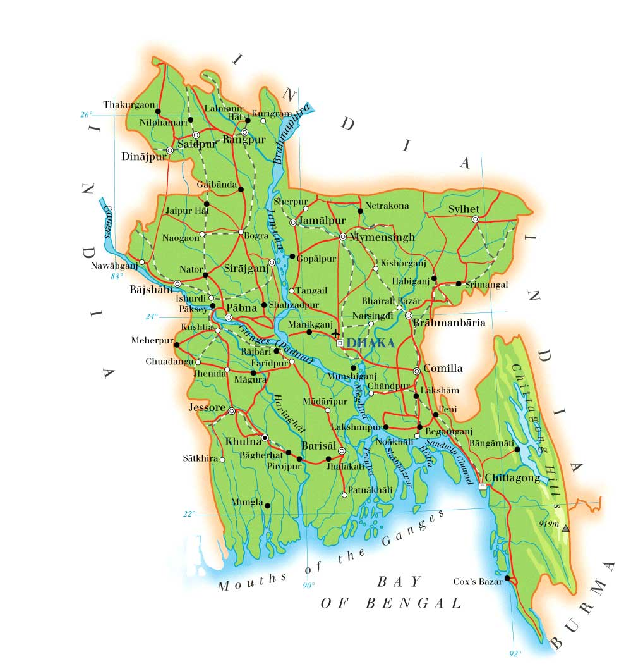
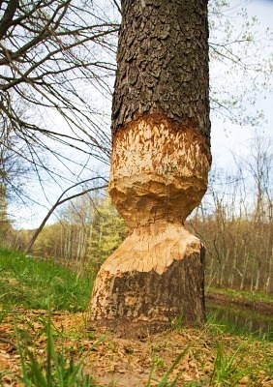
When you complete the drawing of map,
He cut the tree but,
it
will be identified.
didn’t finish it.

Slide 5
Can you guess what we are
going to learn ?
Today our text about completing sentences

Slide 6
O b j e c t i v e s-:
By the end of the lesson
the learners will be able to complete the incomplete sentences--

Slide 7
There is an incomplete sentence in your question paper,you will have to complete it. In this regard there is no alternative to have a knowledge about,-number, verb, clause, tense & proverb etc.
There are some rules to complete the sentence and they are:--

Slide 8
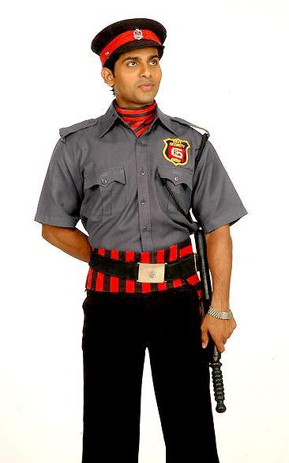
Rule-1: কোন sentence এ Lest থাকলে Lest এর পরবর্তি অংশের গঠন হবে,- Sub + should + verb + exten. For example:-
The guard watches carefully lest--
the thief should enter the house.

Slide 9
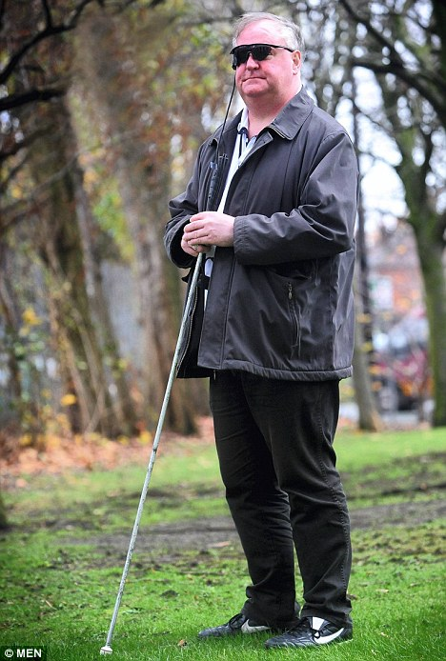
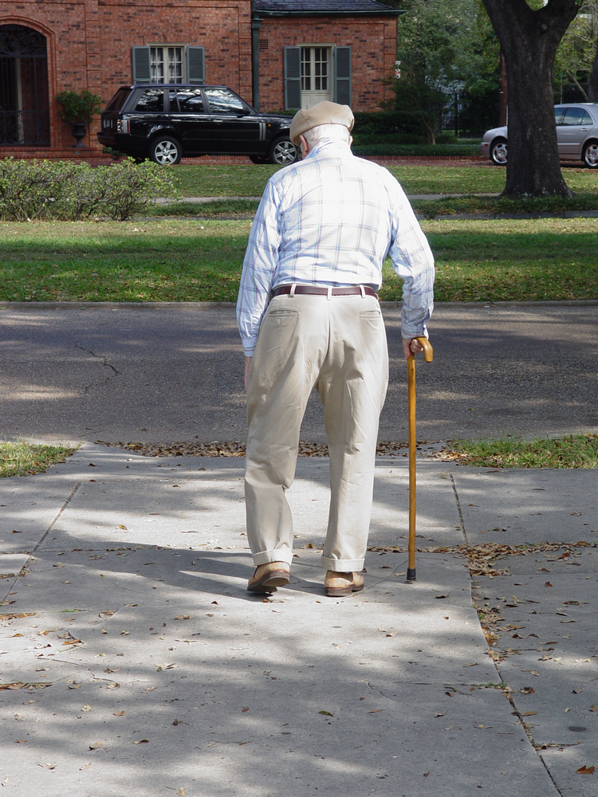
The blind man walks slowly lest--
he should fall down on the ground.

Slide 10
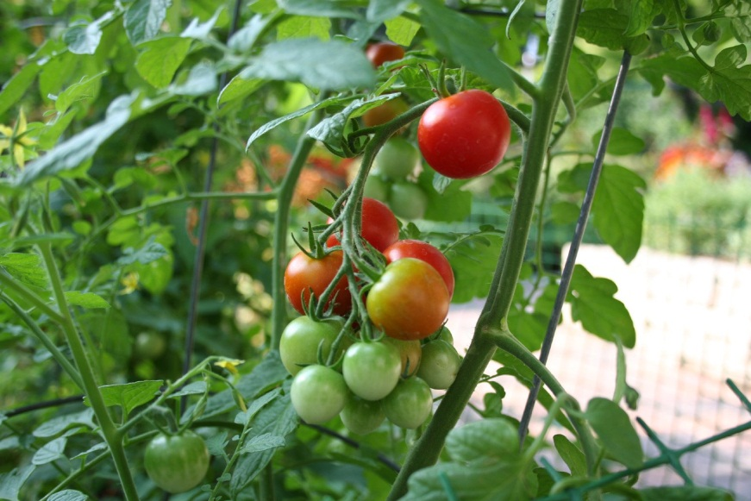
Rule-2: কোন sentence এ so that / in order that থাকলে এর পরের অংশের গঠন হবে,- Sub + can / could, may / might + verb + exten. For example:-
We eat vegetables so that-
we can get vitamin C.

Slide 11
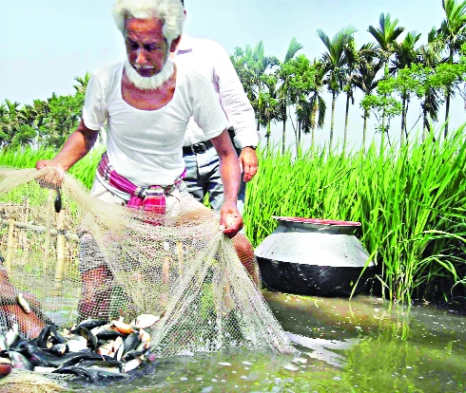
He catches fishes in the Haore in order that-
he may support his family well.

Slide 12
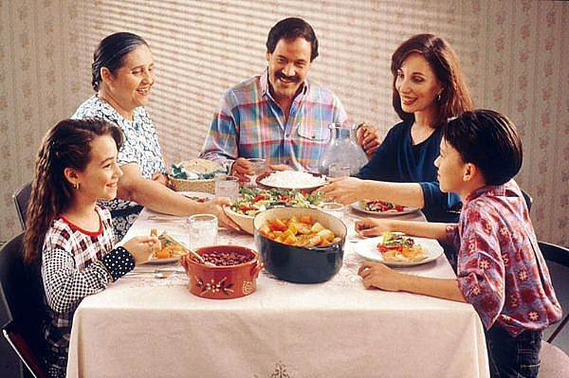
They eat balance diet so that-
they may lead a healthy life.

Slide 13
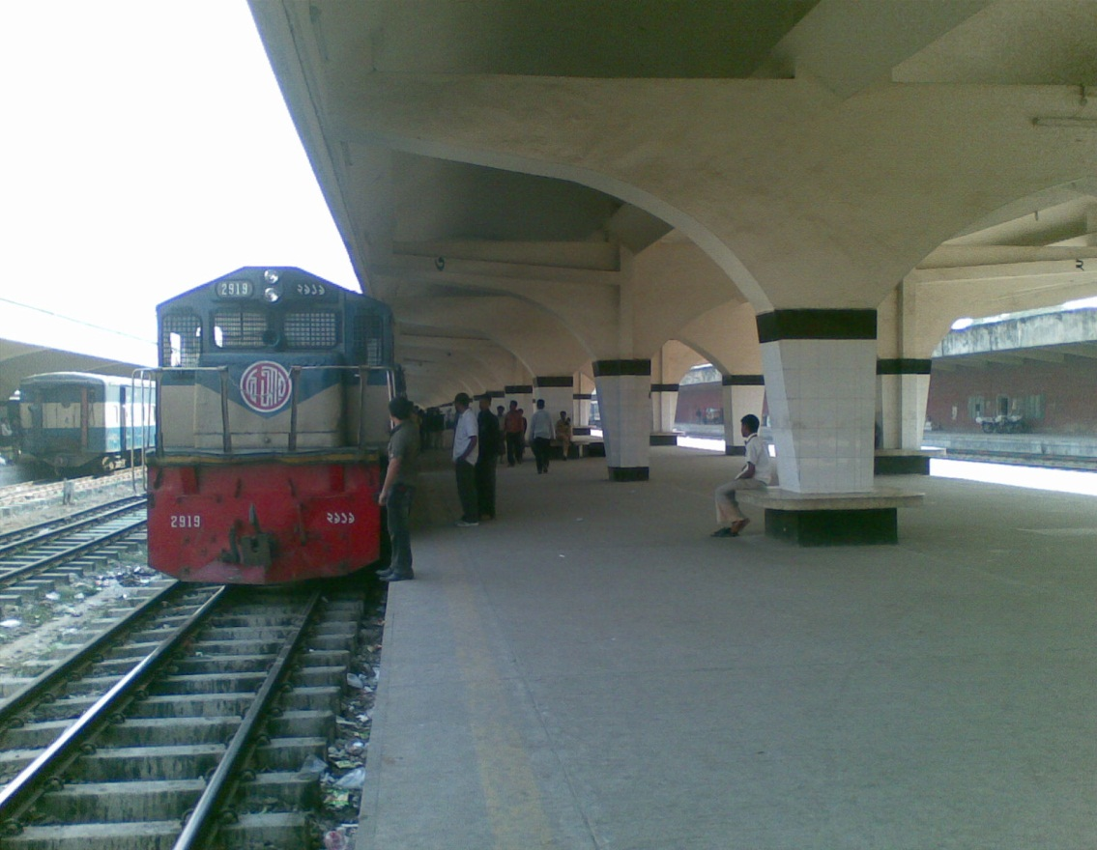
Rule-3:No sooner had …..than / Hardly had …..before / Scarcely had ……when যুক্ত Sentence এর পরের অংশ Past indefinite Tense এ লিখতে হয় । যেমন-
No sooner had we reached the station-
than the train left.

Slide 14
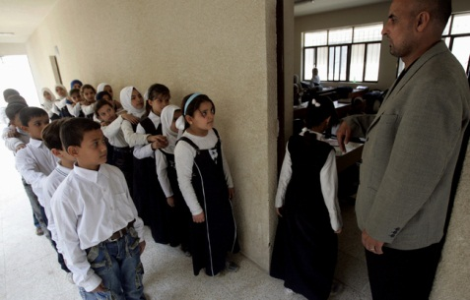
Scarcely had the teacher entered the class room
when the students stood up.

Slide 15
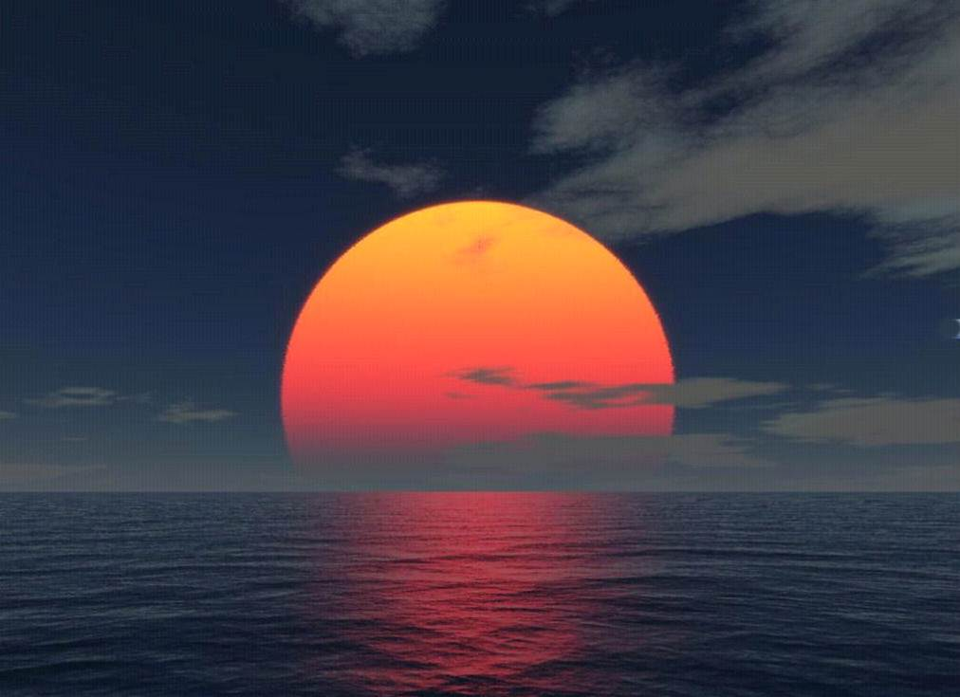
Hardly had the sun set
before we returned home.

Slide 16
Rule-4: It is high time / It is time যুক্ত Sentence এর পরের অংশ Simple Past Tense এ লিখতে হয় । যেমন-
It is high time-
It is high time-
they left home
They met together

Slide 17
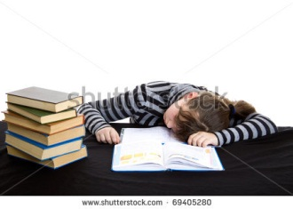
Rule-5: Unless negative word তাই unless যুক্ত Clause এর সাথে not বসেনা এবং এর পরের অংশে Will / Imperative format এ লিখতে হয় । যেমন-
Unless you practice more
you will know nothing.
Unless you study more
Come at8pm unless
you will fail.
I will phone.

Slide 18
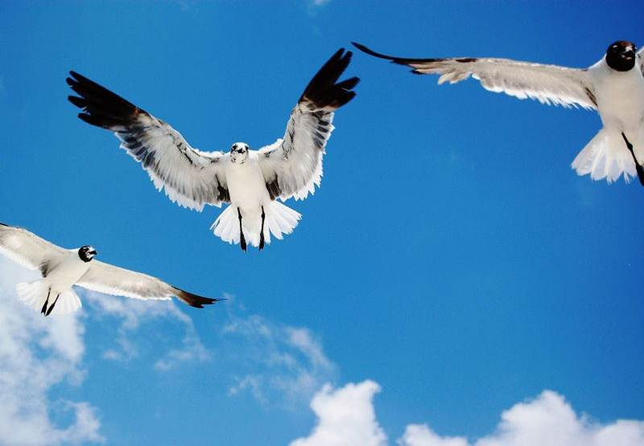
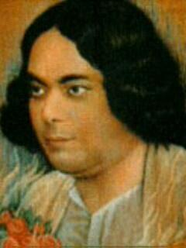
Rule-6: If যুক্ত Clause এ Sub. পর were থাকলে Principal clause এ Sub. এর পর might / could / would + ext বসে। যেমন-
If I were Nazrul,
I would write many songs.
If I were a bird,
I would fly in the sky.

Slide 19
Rule-7: If যুক্ত Clause টি present indefinite হলে principal clause টি future indefinite হয়। যেমন-
If it rains,
we will not go.
If he wants ,
I shall help him.
Rule-8: If যুক্ত Clause টি past indefinite হলে principal clause টি past conditional (would, might, could হয়। যেমন-
If he came,
I would go.
If I had a lot of money,
I would buy a car.
Rule-9: If যুক্ত Clause টি past perfect হলে principal clause টি perfect conditional (would have, might have, could have) হয়। যেমন-
If I had seen him,
I might have told him the news.
If he had tried ,
he would have got GPA-5.

Slide 20
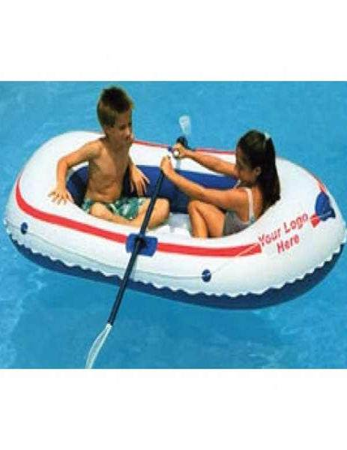
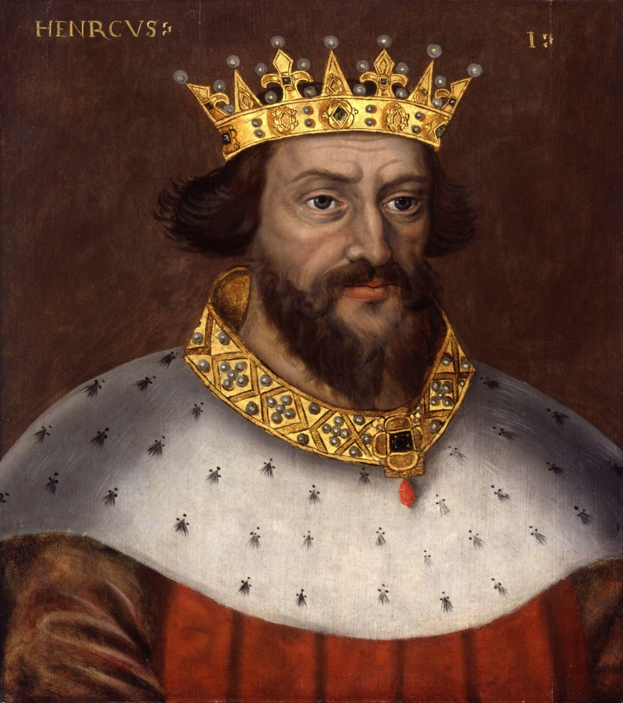
Rule-10: Would that / I wish যুক্ত sentence এ sub. পর verb এর স্থানে Were বসে। যেমন-
Would that I
were a child again.
I wish I
were a king.

Slide 21
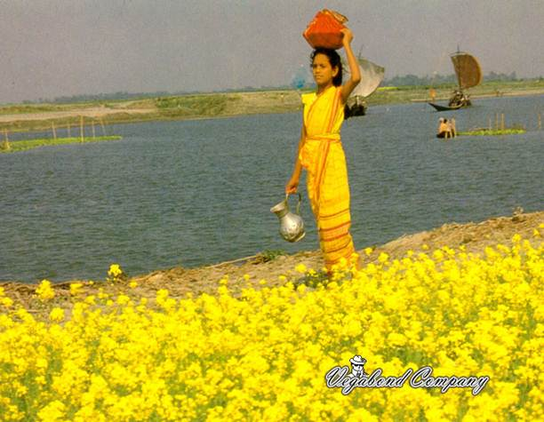
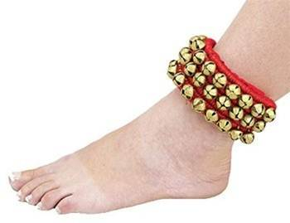
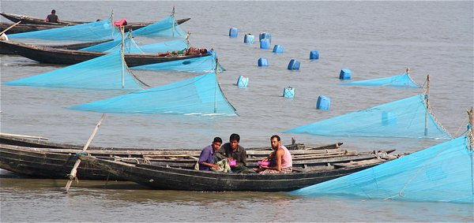
Rule-11: In spite of / despite of ( সত্বেও )যুক্ত Clause এর পরের অংশ, বৈপরিত্য অর্থ প্রকাশ পায় এমন একটি clause দ্বারা complete করতে হয়। যেমন-
In spite of dancing well,
she was not rewarded.
Despite of working hard ,
the fishermen get poor salary.

Slide 22
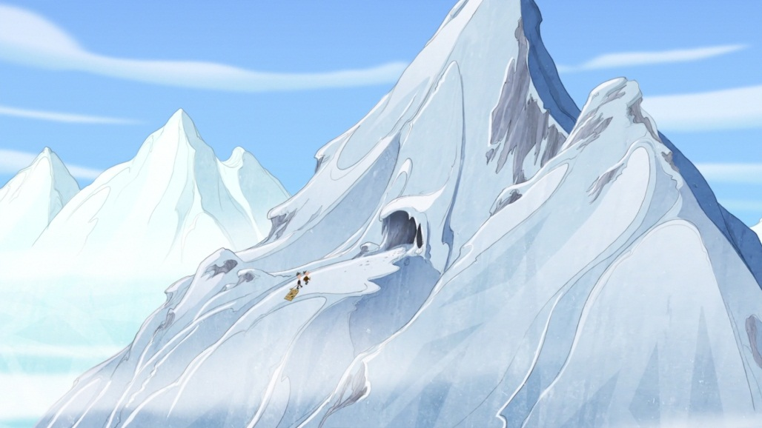
Rule-12: Since যুক্ত sentence এ since এর পুর্বে simple present tense হলে since এর পর simple past tense হয় এবং since এর পুর্বে simple past হলে since এর পর past perfect হয়। যেমন-
Many years passed since
I had visited the Himalayas.
Many years have passed since
I met you last.
It is many years since
I visited her.

Slide 23
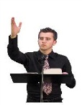
Rule-13: As if / As though এর আগের অংশ Simple present হলে পরের অংশ Simple past এবং এর আগের অংশ Simple past হলে পরের অংশ Past perfect Tense হয়। যেমন-
He speaks as if-
he knew everything.
He acts as if –
he were a mad.

Slide 24
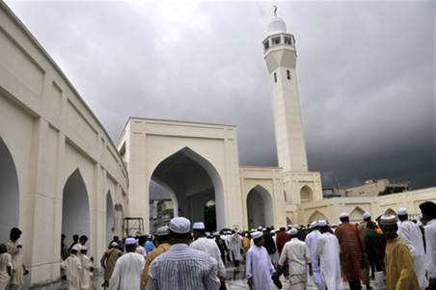
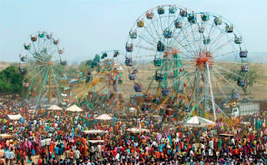
Rule-14: “The place where” এরুপ থাকলে পরের অংশ simple present এ লিখতে হয়। যেমন-
Mosque is the place where-
Muslims say their prayer.
Village fair is a place where-
villagers sell their commodities.

Slide 25
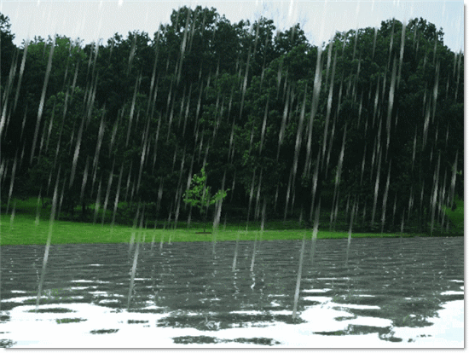
Rule-15: “As soon as” যুক্ত sentence এর উভয় পাশে একই tense হয়। যেমন-
We went to the river as soon as-
it started to rain.

Slide 26
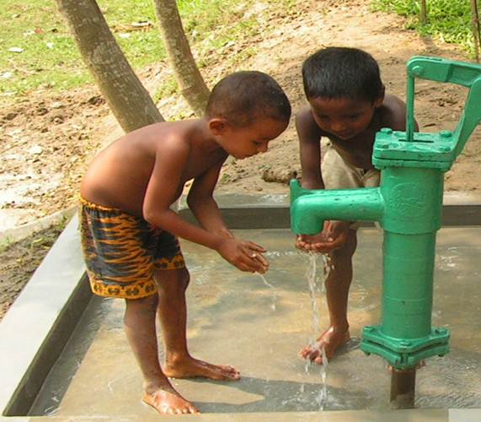
Rule-16: Zero condition যুক্ত sentence এর উভয় পাশে একই tense হয়। সাধারনতঃ Present tense অথবা imperative sentence এ এটা বেশি হয় ।যেমন-
Drink safe water if-
Read attentively if-
you want to alive.
you want to pass.

Slide 27
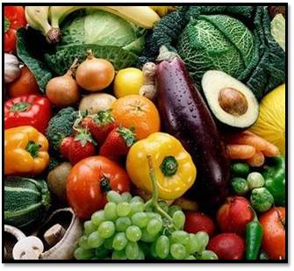
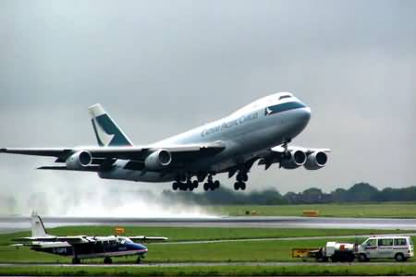
Rule-17:Provided / provided that / providing that এর অর্থ যদি / যদি ধর / যদি কিনা ইত্যাদি। উক্ত শব্দ যুক্ত Sentence এর শেষে সঙ্গতি পুর্ন একটি বাক্যাংশ লিখতে হয়। যেমন-
We can keep our body fit provided
that..we eat fruits regularly.
The plan will take off in time provided..
the weather is good.

Slide 28
Rule-18: Let alone এর অর্থ “ভাবা যায়না” / “চিন্তা করা যায়না”।এ ধরনের Sentence এর শেষে সঙ্গতি পুর্ন একটি বাক্যাংশ লিখতে হয়। যেমন-
He can not get GPA- 2.oo, let alone..
minimum GPA 4.5
I can not swim a kilometer, let alone..
Ten kilometers.

Slide 29
Pair work
Complete the following sentences.
a) They ran hurriedly lest-
they should fall behind.
b)Drink pure water if-
you want to lead disease-fee life.
c) It is high time –
we changed our decision.
d) No sooner had we gone there than-
she left the place.
e)If I were a millionaire-
I would build a magnificenat palace .

Slide 30
Evaluation
a) As soon as he saw the police,-
he fled away.
b) Though he studied more,--
he couldn’t pass in the exam.
c) We take exercise regularly so that -,
we can keep our body fit.
d) Fifteen years have passed,-
I had joined in this school.
e) He is not only a teacher,-
but also a business man.

Slide 31
Home work
Try to complete the incomplete sentences by using,-Lest, Since, No sooner had, As soon as, In spite of, Let alone, So that, It is high time, If, As if etc.

Slide 32
“Good bye !
See you next .”

